Slide 1
RT for ML & ML for RT
Jinkyu Lee
Department of Computer Science and Engineering
Sungkyunkwan University (SKKU)
SKKU AI Colloquium | November 5th, 2021

Slide 2


Overview
Real-Time Systems
Machine Learning
RT
ML

Slide 3
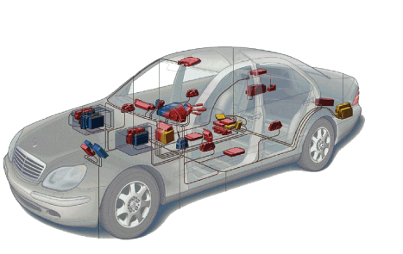
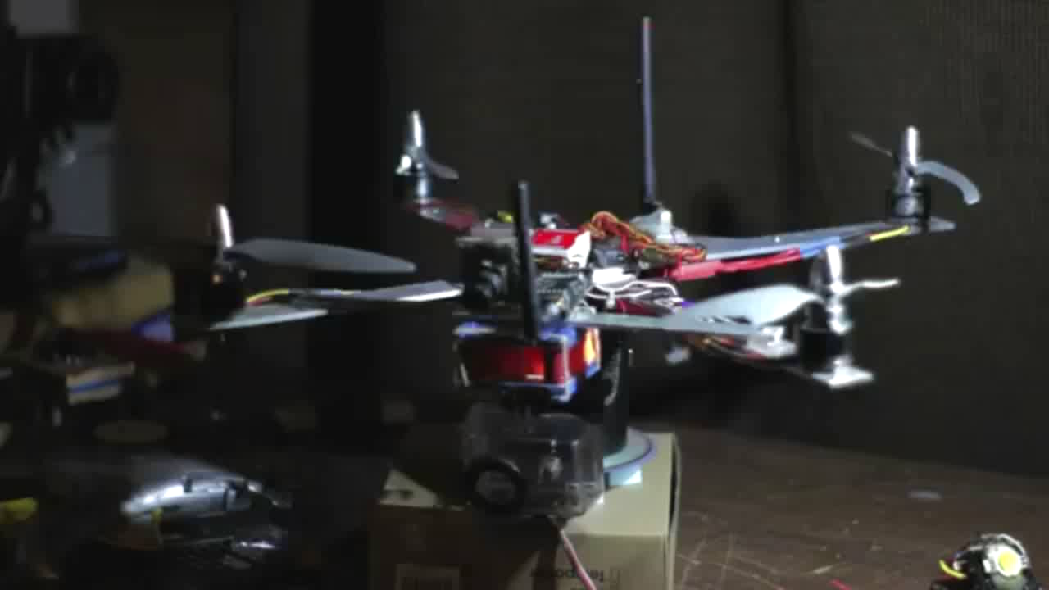

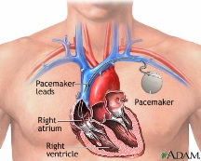
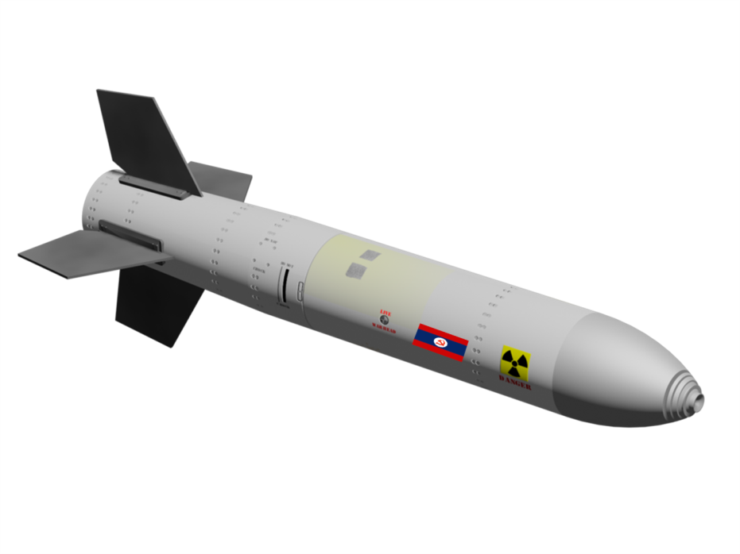
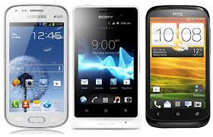


Real-Time System
Systems that operate with time constraints (deadlines)
Important to produce accurate results before deadlines
Usually for safety-critical systems or mission-critical systems
Automotive
Avionics
Medical Devices
Robots
Military
Smartphones
Multimedia
Factory Automation

Slide 4
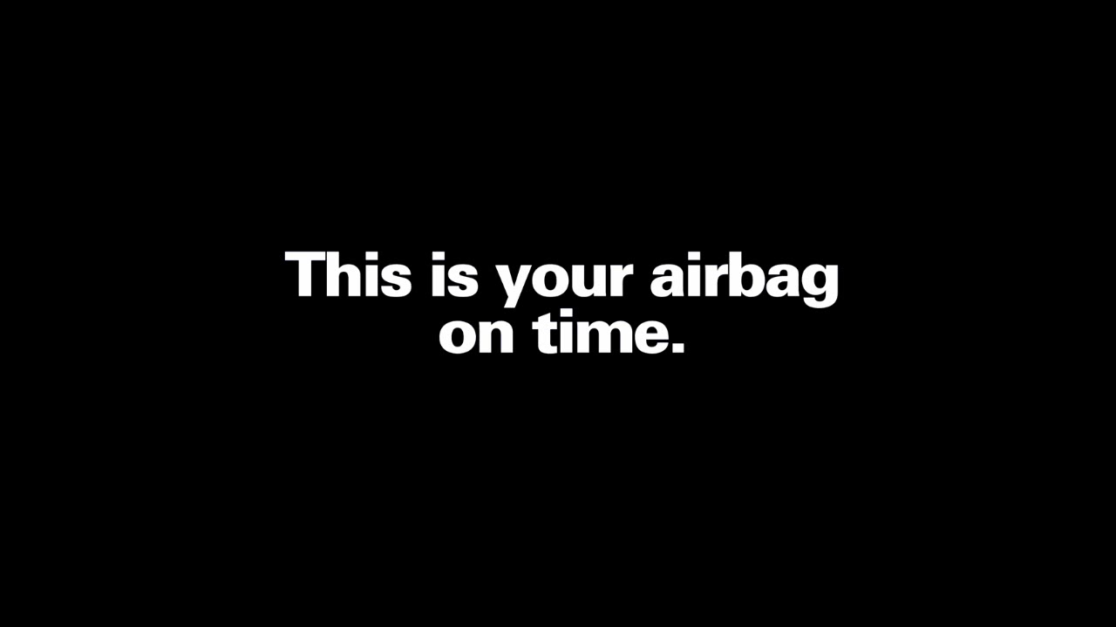
Real-Time System
Systems that operate with time constraints (deadlines)
Important to produce accurate results before deadlines
Usually for safety-critical systems or mission-critical systems
From Honda

Slide 5



Real-Time System
Systems that operate with time constraints (deadlines)
Important to produce accurate results before deadlines
Usually for safety-critical systems or mission-critical systems

Slide 6






Real-Time Systems: Research Topics
Design time-predictable
computing systems
Timing guarantee and analysis
of computing systems
+
Applications
Languages
Operating Systems
Middleware
Architecture
Hardware
…
[1] Cyber Physical Systems: Design Challenges, IEEE ISORC, 2008.
[2] MC-SDN: Supporting Mixed-Criticality Real-Time Communication
Using Software-Defined Networking, IEEE IoT Journal, 2019.

Slide 7
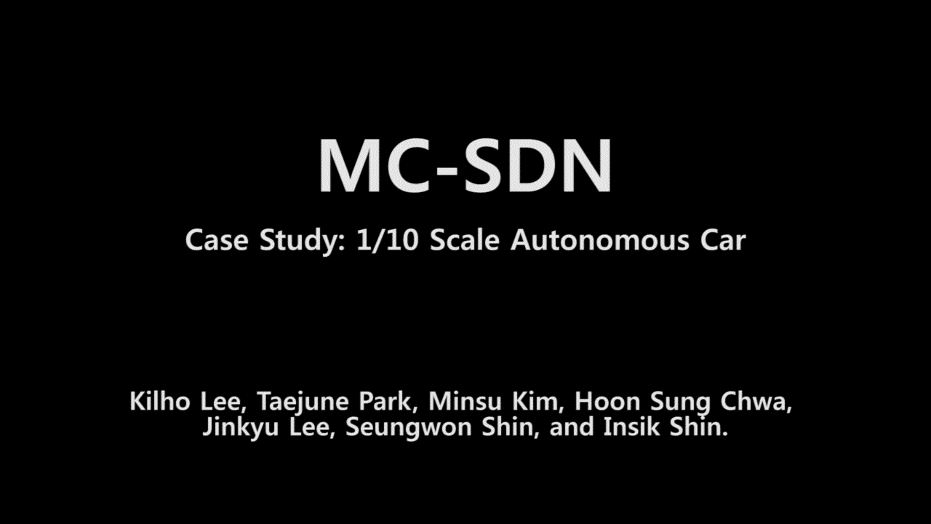
Real-Time Systems: Research Topics
Design time-predictable
computing systems
Timing guarantee and analysis
of computing systems
+
[2] MC-SDN: Supporting Mixed-Criticality Real-Time Communication
Using Software-Defined Networking, IEEE IoT Journal, 2019.

Slide 8
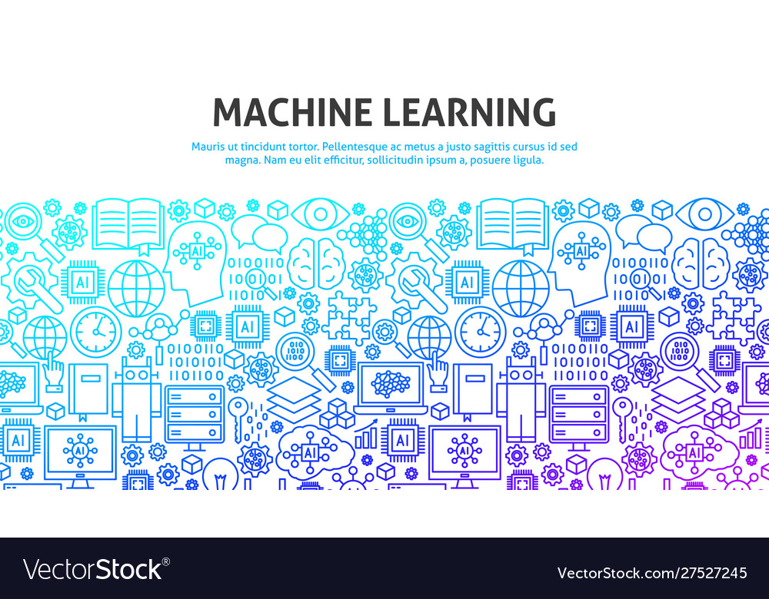
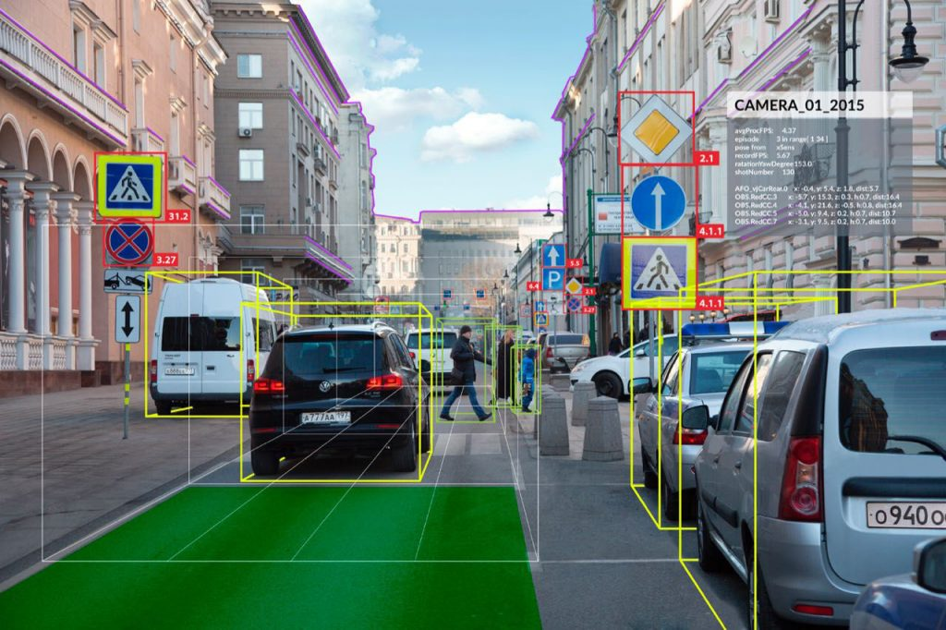


When ML Met RT
RT Challenges
Novel Approach
ML for RT
ML
Processing Characteristics
…
Domain
Knowledge
…
RT
RT for ML
Timing Guarantee
ML Applications

Slide 9
RT for ML
Goal
Time-predictable (shorter) execution for DNN tasks
Analysis of execution delay upper-bound (timing guarantee)
Energy consumption reduction
Control knob
Execution order
Execution behavior (e.g., pipeline execution, CPU/GPU concurrent execution)
Approximation
RT
RT for ML
Timing Guarantee
ML Applications
Notes:
IEEE RTSS (Real-Time Systems Symposium): Top 1 Conference in the area of real-time systems
IEEE RTAS (Real-Time and Embedded Technology and Applications Symposium): Top 2 Conference in the area of real-time systems

Slide 10
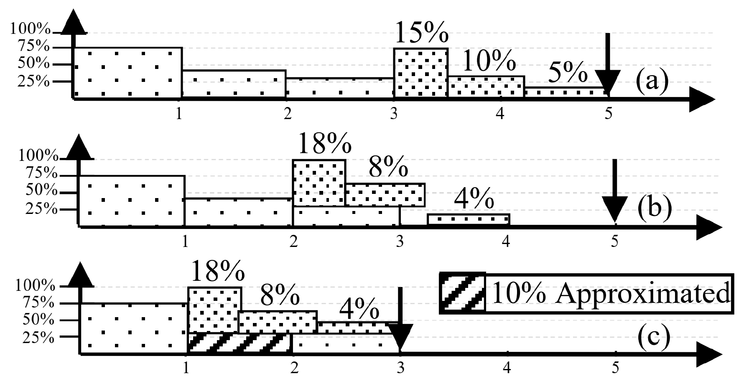
RT for ML: Recent Studies
Since 2018, “RT for ML” studies have been published in RT top conferences.
Study [3]
Study [4]
IEEE RTSS: Real-Time Systems Symposium
IEEE RTAS: Real-Time and Embedded Technology and Applications Symposium
[3] S3DNN: Supervised Streaming and Scheduling for GPU-accelerated Real-Time DNN Workloads, IEEE RTAS 2018
[4] ApNet: Approximation-aware Real-Time Neural Network, IEEE RTSS 2018
[5] PredJoule: A Timing-Predictable Energy Optimization Framework for Deep Neural Network, IEEE RTSS 2018

Slide 11
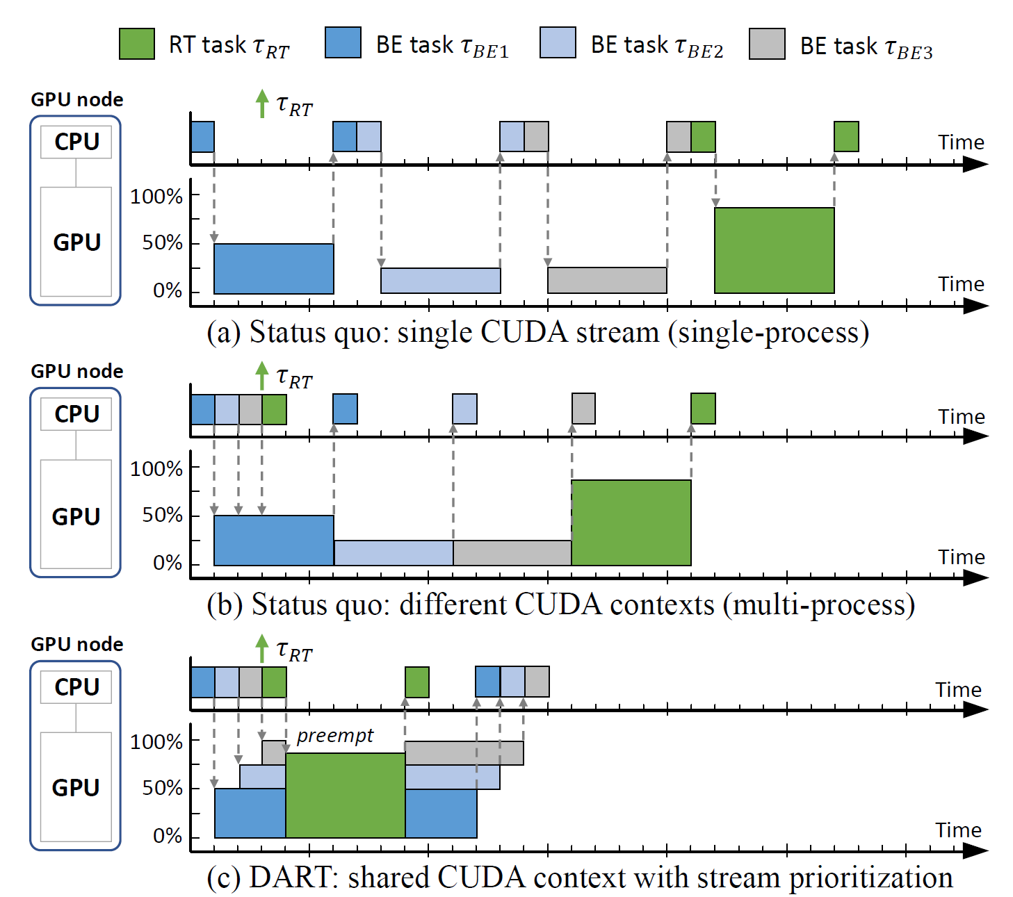
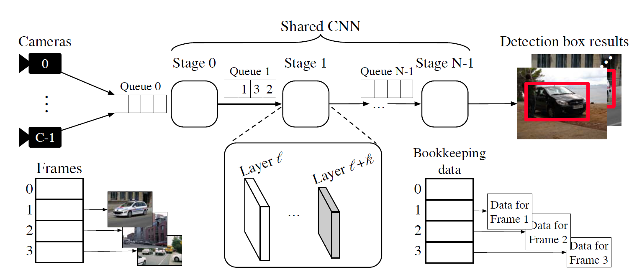
RT for ML: Recent Studies
Study [7]
Study [6]
[6] Re-thinking CNN Frameworks for Time-Sensitive Autonomous-Driving Applications, IEEE RTAS 2019
[7] Pipelined Data-Parallel CPU/GPU Scheduling for Multi-DNN Real-Time Inference, IEEE RTSS 2019
[8] Real-Time Object Detection System with Multi-Path Neural Networks, IEEE RTAS 2020

Slide 12
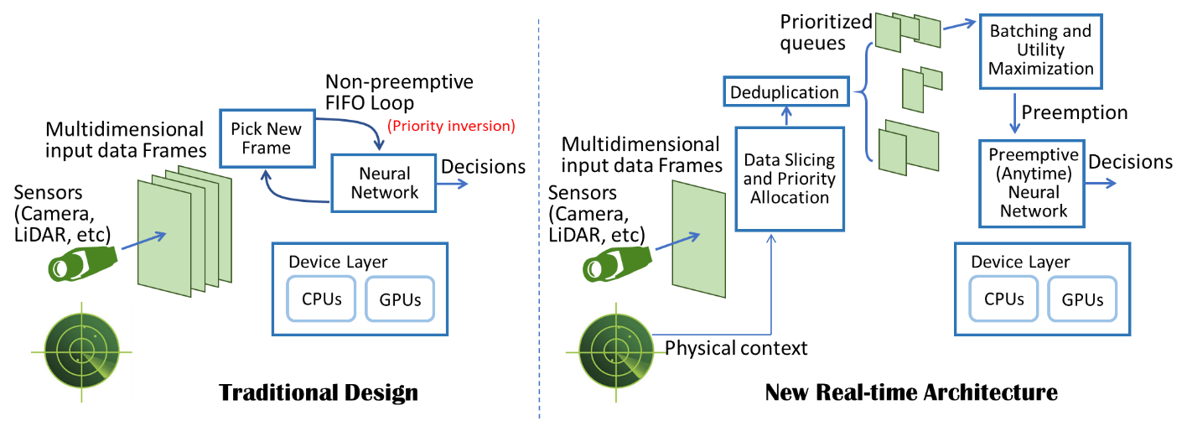
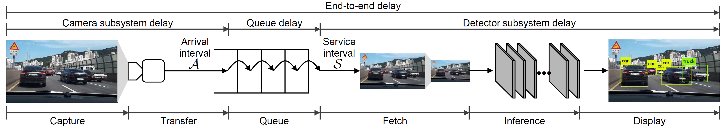
RT for ML: Recent Studies
Study [9]
Study [10]
[9] On Removing Algorithmic Priority Inversion from Mission-Critical Machine Inference Pipelines, IEEE RTSS 2020
[10] R-TOD: Real-Time Object Detector with Minimized End-to-End Delay for Autonomous Driving, IEEE RTSS 2020

Slide 13




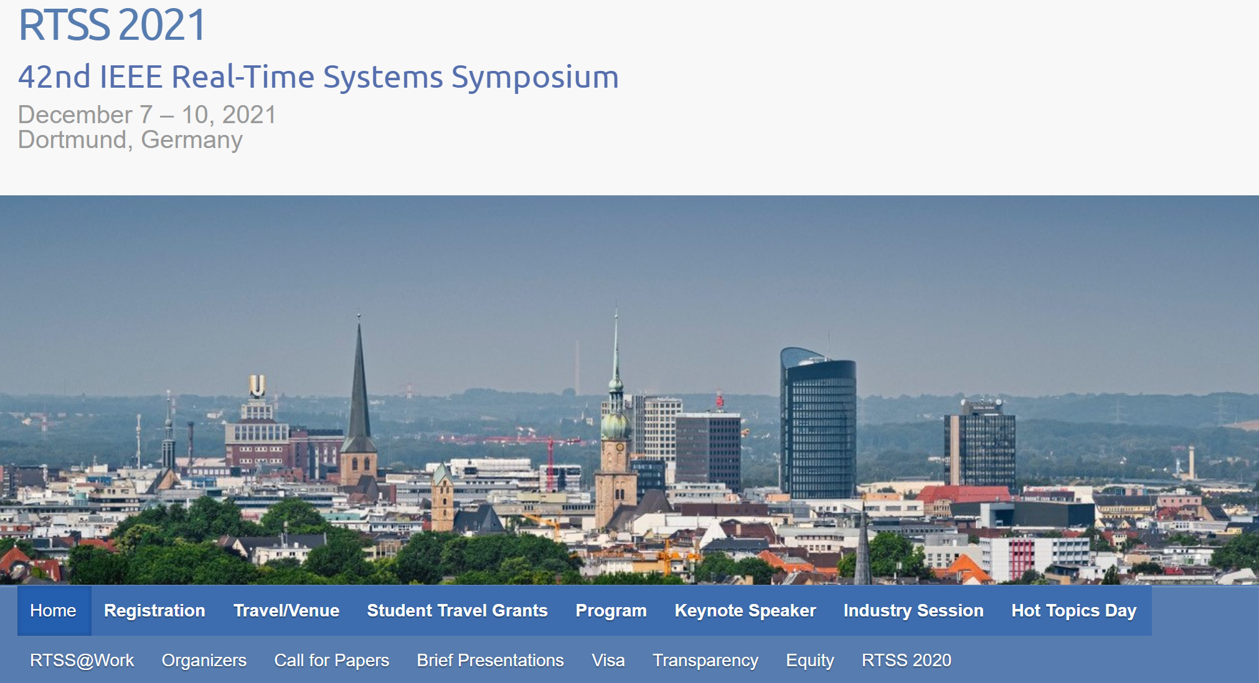
RT for ML: Our Research
Motivation
How to fully utilize CPU and GPU for time-predictable execution for DNN tasks?
[11] LaLaRAND: Flexible Layer-by-Layer CPU/GPU Scheduling for Real-Time DNN Tasks,” IEEE RTSS 2021

Slide 14
RT for ML: Our Research
Motivation
How to fully utilize CPU and GPU for time-predictable execution for DNN tasks?
Challenges & opportunity
CPU vs GPU performance imbalance in DNN Execution
CPU-friendly quantization but accuracy drop
Different per-layer execution times
[11] LaLaRAND: Flexible Layer-by-Layer CPU/GPU Scheduling for Real-Time DNN Tasks,” IEEE RTSS 2021

Slide 15
RT for ML: Our Research
Motivation
How to fully utilize CPU and GPU for time-predictable execution for DNN tasks?
Challenges & opportunity
CPU vs GPU performance imbalance in DNN Execution
CPU-friendly quantization but accuracy drop
Different per-layer execution times
[11] LaLaRAND: Flexible Layer-by-Layer CPU/GPU Scheduling for Real-Time DNN Tasks,” IEEE RTSS 2021

Slide 16
RT for ML: Our Research
Motivation
How to fully utilize CPU and GPU for time-predictable execution for DNN tasks?
Challenges & opportunity
CPU vs GPU performance imbalance in DNN Execution
CPU-friendly quantization but accuracy drop
Different per-layer execution times
[11] LaLaRAND: Flexible Layer-by-Layer CPU/GPU Scheduling for Real-Time DNN Tasks,” IEEE RTSS 2021

Slide 17
RT for ML: Our Research
Problem statement
Time-predictable execution for DNN tasks, their timing guarantees, and no accuracy drop
By fully utilizing not only GPU but also CPU with quantization
Solution approach
Efficient layer-by-layer CPU/GPU allocation
Framework design and implementation
[11] LaLaRAND: Flexible Layer-by-Layer CPU/GPU Scheduling for Real-Time DNN Tasks,” IEEE RTSS 2021

Slide 18
RT for ML: Our Research
Offline layer allocation
Based on the worst-case execution behavior
Run-time layer migration
Based on the actual execution behavior (using slack)
Timing analysis
Layer allocation
Timing guarantee, but accuracy loss
Online GPU/CPU re-allocation
Timing guarantee, and no accuracy loss
[11] LaLaRAND: Flexible Layer-by-Layer CPU/GPU Scheduling for Real-Time DNN Tasks,” IEEE RTSS 2021

Slide 19
RT for ML: Our Research
Evaluation
NVIDIA Jetson Xavier board
GoogLeNet, MnasNet, SqueezeNet, and MobileNetV2
Accuracy
Timing guarantee
[11] LaLaRAND: Flexible Layer-by-Layer CPU/GPU Scheduling for Real-Time DNN Tasks,” IEEE RTSS 2021

Slide 20
ML for RT
Goal
Solving challenging problems in the area of real-time systems
By the collaboration of machine learning techniques and domain knowledge of real-time systems
Research trend
Problem by problem approach (at least so far)
RT Challenges
Novel Approach
ML for RT
ML
Notes:
Goal
Solving challenging problems in the area of real-time systems
By the collaboration of machine learning techniques and domain knowledge of real-time systems
RT의 challenging 문제에 대한 이해, RT guarantee에 대한 이해, 어떤 ML이 해당 문제에 적절한 지에 대한 고찰
Research trend
Problem by problem approach (at least so far)

Slide 21
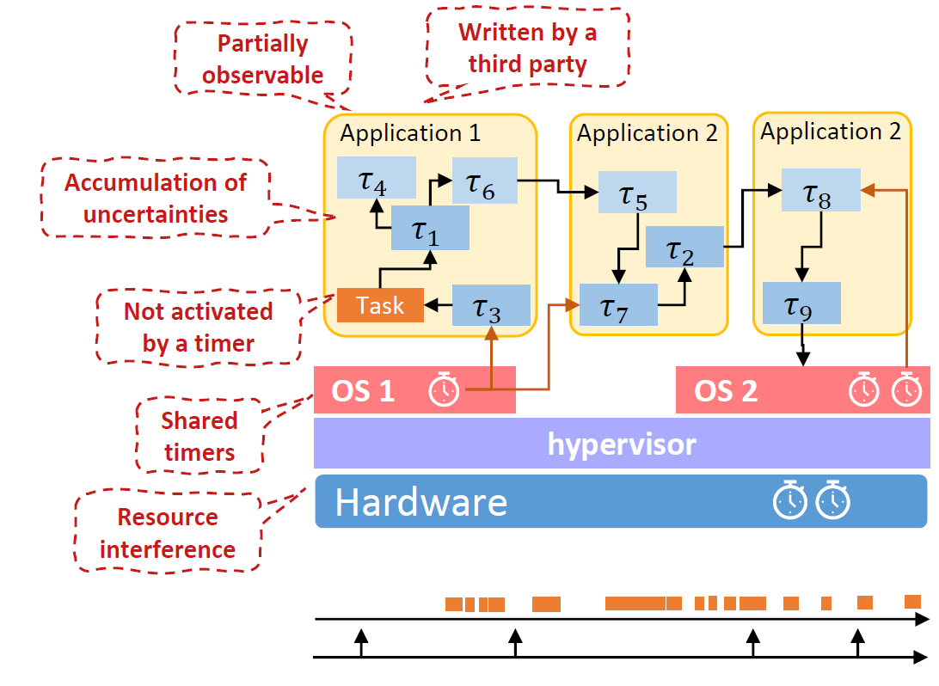
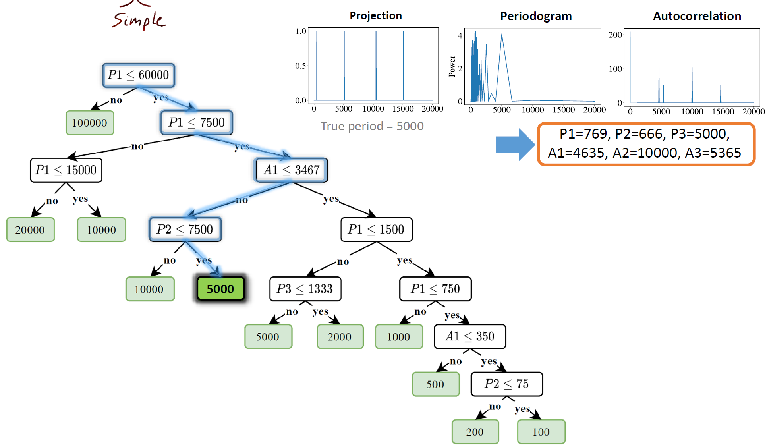
ML for RT: Recent Studies
Problem in [13]: how to schedule real-time tasks using machine learning?
Problem in [12]: how to infer task parameters of real-time systems?
[12] Robust and Accurate Period Inference using Regression-Based Techniques, IEEE RTSS 2020
[13] Developing Real-Time Scheduling Policy by Deep Reinforcement Learning, IEEE RTAS 2021

Slide 22


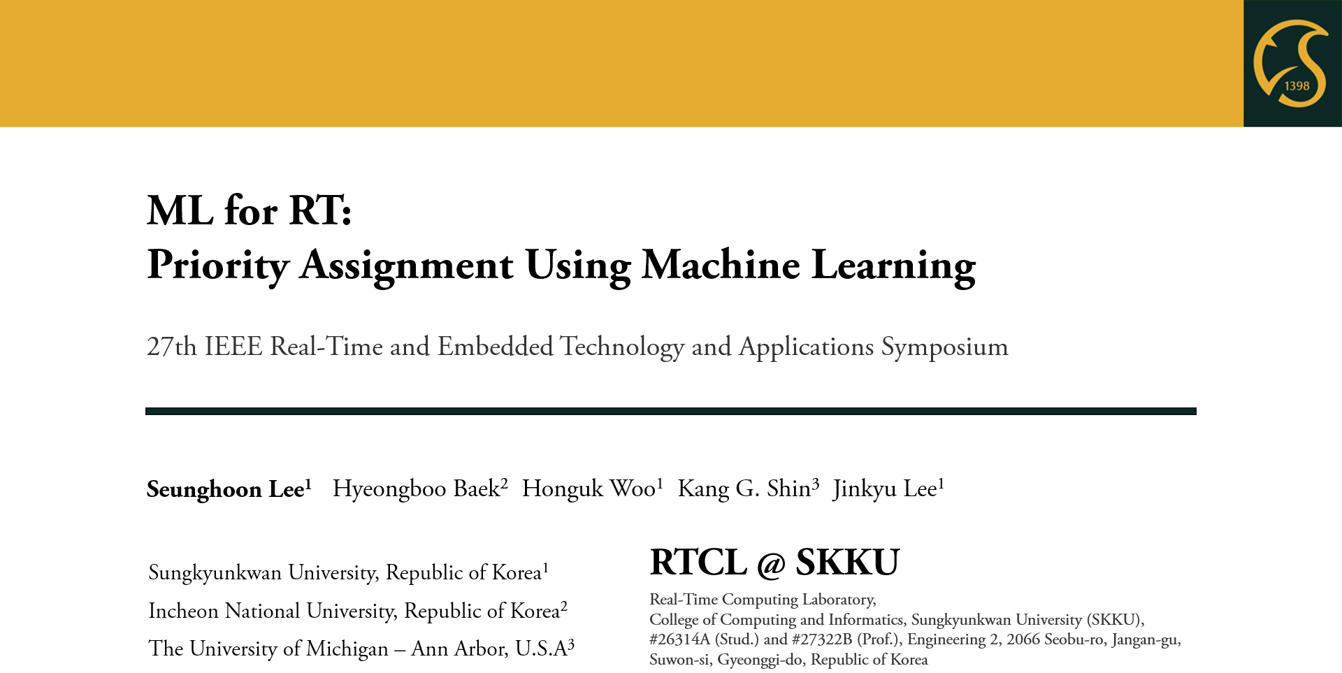
ML for RT: Our Research
Our research [14] will be presented in the next session.
By Seunghoon Lee, a graduate student in Real-Time Computing Lab.
https://rtclskku.github.io/website/
[14] ML for RT: Priority Assignment Using Machine Learning, IEEE RTAS 2021

Slide 23
Conclusion
RT for ML: future research direction
Toward more challenging ML applications, e.g., object tracking
Timing-aware design of neural networks
ML for RT: future research direction
Identification of types of RT challenges suitable for “ML for RT”
ML-oriented scheduling that provides timing guarantees
Real-Time Systems
Machine Learning
RT
ML
Notes:
Toward more challenging ML applications, e.g., object tracking

Slide 24
Thank you for your attention!
Real-Time Computing Lab.
https://rtclskku.github.io/website/

Slide 25
Abstract
In this talk, I cover recent research topics related to ML (Machine Learning), discussed in the real-time systems community. The topics can be classified into two categories: (i) how to provide timing guarantees for running ML-related computations, (ii) how to utilize ML techniques for solving challenging problems of the real-time systems. I introduce the research trend for (i) and (ii), including my recent studies for (i) and (ii).
In this talk, I explain which research topics related to ML (Machine Learning) have been studied in the real-time systems community. The research topics can be classified into two categories: (1) how to provide timing guarantees for running ML-related computations, (2) how to utilize ML techniques for solving the problem of the real-time systems. I explain the research trend for (1) and (2), as well as my recent studies for (1) and (2).

Slide 26
Abstract
Recently, research topics related to ML (Machine Learning) have been widely studied in the RT (Real-Time) systems community, and they can be classified into two categories: (i) how to provide timing guarantees for running ML-related computations (i.e., RT for ML), (ii) how to utilize ML techniques for solving challenging problems of RT systems (i.e., ML for RT). In this talk, I introduce the research trend for (i) and (ii), including my recent studies for (i) and (ii).
In this talk, I cover recent research topics related to ML (Machine Learning), discussed in the real-time systems community. The topics can be classified into two categories: (i) how to provide timing guarantees for running ML-related computations, (ii) how to utilize ML techniques for solving challenging problems of the real-time systems. I introduce the research trend for (i) and (ii), including my recent studies for (i) and (ii).

Slide 27
Overview
RT: Real-Time Systems
ML: Machine Learning
Real-Time (RT) System
Proliferation of ML: How to Affect RT?
RL for ML
ML for RT
Conclusion and Future Direction
+

Slide 28



Overview
RT
ML
Real-Time Systems
+
Machine Learning
Real-Time (RT) Systems
1
Proliferation of ML: How to Affect RT?
Future Direction
5
2
RT + ML
4
3
ML for RT
RT for ML

Slide 29
Overview
RT
+
ML
Real-Time Systems
Machine Learning
Real-Time (RT) Systems
1
Proliferation of ML: How to Affect RT?
Future Direction
5
2
RT + ML
4
3
ML for RT
RT for ML

Slide 30



Overview
RT
ML
Real-Time Systems
Machine Learning
Real-Time Systems
1
Proliferation of ML: How to Affect RT?
Future Direction
5
2
RT + ML
4
3
ML for RT
RT for ML

Slide 31

Overview
Real-Time System
Machine Learning
RT
ML

Slide 32
Overview
RT
ML
Real-Time Systems
Machine Learning
Real-Time Systems
1
Proliferation of ML: How to Affect RT?
Future Direction
5
2
RT + ML
4
3
ML for RT
RT for ML

Slide 33
Overview
RT
ML
Real-Time Systems
Machine Learning
Real-Time Systems
1
Proliferation of ML: How to Affect RT?
Future Direction
5
2
RT + ML
4
3
ML for RT
RT for ML

Slide 34
Overview
RT
ML
Real-Time Systems
Machine Learning

Slide 35
Overview
Real-Time Systems
RT
ML
Real-Time Systems
Machine Learning

Slide 36
Overview
Real-Time Systems
1
Proliferation of ML: How to Affect RT?
Future Direction
5
2
RT + ML
4
3
ML for RT
RT for ML

Slide 37
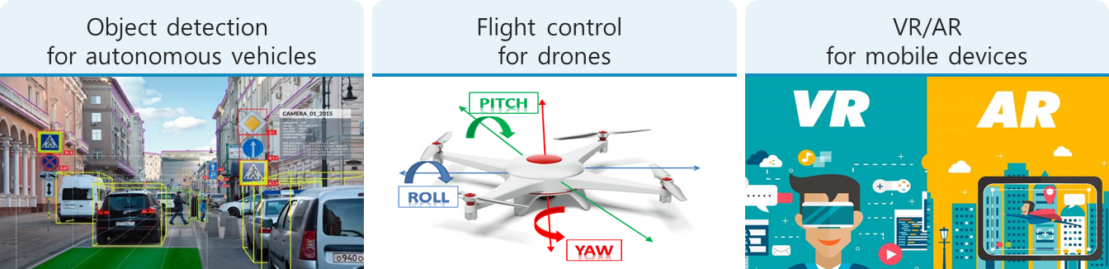
Proliferation of ML: How to Affect RT?
자율주행 자동차, UAV 등의 object detection 등 safety-critical한 system에서의 RT guarantee 필요 -> 굉장히 복잡하고 heavy한 ML computation
RT for ML
ML technique이 발달함에 따라 기존에 RT의 challenges 들을 ML을 활용하여 해결해볼만 함.
ML for RT
Notes:
자율주행 자동차, UAV 등의 object detection 등 safety-critical한 system에서의 RT guarantee 필요 -> 굉장히 복잡하고 heavy한 ML computation
RT for ML
ML technique이 발달함에 따라 기존에 RT의 challenges 들을 ML을 활용하여 해결해볼만 함.
ML for RT

Slide 38
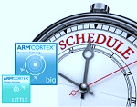
Proliferation of ML: How to Affect RT?
ML

Slide 39
Proliferation of ML and Its Impact on RT
RT Challenges
Novel Approach
ML
Processing Characteristics
Domain
Knowledge
RT
Timing Guarantee
ML Applications

Slide 40
Conclusion
Active research for ML+RT in the real-time systems community
RT for ML
ML for RT
Future research direction for RT for ML
Toward more challenging ML applications, e.g., object tracking
Timing-aware design of neural networks
Future research direction for ML for RT
Identification of types of RT challenges suitable for ML for RT
ML-oriented scheduling, but timing guarantees
RT
ML
Notes:
Toward more challenging ML applications, e.g., object tracking

Slide 41
Real-Time Systems: Research Topics
Design a time-predictable
computing system
Design a time-predictable
computing system
Timing guarantee and analysis of
a computing system
+
Applications
Languages
Operating Systems
Middleware
Architecture
Hardware
…
[1] Cyber Physical Systems: Design Challenges, IEEE ISORC, 2008.
[2] MC-SDN: Supporting Mixed-Criticality Real-Time Communication
Using Software-Defined Networking, IEEE IoT Journal, 2019.

Slide 42
Real-Time Systems: Research Topics
Design a time-predictable computing system
Timing guarantee of a computing system
+
Languages
Operating Systems
Middleware
Architecture
Hardware
…
[1] Cyber Physical Systems: Design Challenges, IEEE ISORC, 2008.

Slide 43

Real-Time Systems: Research Topics
How to design a time-predictable computing system?
How to provide timing guarantees of a target computing system?
Languages
Operating Systems
Middleware
Architecture
Hardware
…
Battery Performance
Improvement
Timing Guarantees
[1] Cyber Physical Systems: Design Challenges, IEEE ISORC, 2008.

Slide 44
RT for ML
Early-stage studies
[3] S3DNN: Supervised Streaming and Scheduling for GPU-accelerated Real-Time DNN Workloads, IEEE RTAS 2018
[4] PredJoule: A Timing-Predictable Energy Optimization Framework for Deep Neural Network, IEEE RTSS 2018
[5] ApNet: Approximation-aware Real-Time Neural Network, IEEE RTSS 2018
[6] Re-thinking CNN Frameworks for Time-Sensitive Autonomous-Driving Applications: Addressing an Industrial Challenge, IEEE RTAS 2019
[7] Pipelined Data-Parallel CPU/GPU Scheduling for Multi-DNN Real-Time Inference, IEEE RTSS 2019
[8] Real-Time Object Detection System with Multi-Path Neural Networks, IEEE RTAS 2020
[9] R-TOD: Real-Time Object Detector with Minimized End-to-End Delay for Autonomous Driving, IEEE RTSS 2020
[10] On Removing Algorithmic Priority Inversion from Mission-Critical Machine Inference Pipelines, IEEE RTSS 2020
[11] LaLaRAND: Flexible Layer-by-Layer CPU/GPU Scheduling for Real-Time DNN Tasks, IEEE RTSS 2021

Slide 45
RT for ML
Goal
Time-predictable (shorter) execution for DNN tasks
Analysis of execution delay upper-bound (timing guarantee)
Energy reduction
Control knob
Execution order including pipeline execution
Approximation
CPU/GPU concurrent execution
RT
Timing Guarantee
ML Applications
Notes:
IEEE RTSS (Real-Time Systems Symposium): Top 1 Conference in the area of real-time systems
IEEE RTAS (Real-Time and Embedded Technology and Applications Symposium): Top 2 Conference in the area of real-time systems

Slide 46
RT for ML
Goal
Time-predictable (shorter) execution for DNN tasks
Analysis of execution delay upper-bound (timing guarantee)
Energy reduction
Control knob
Execution order including pipeline execution
Approximation
CPU/GPU concurrent execution
RT
ML Applications
Notes:
IEEE RTSS (Real-Time Systems Symposium): Top 1 Conference in the area of real-time systems
IEEE RTAS (Real-Time and Embedded Technology and Applications Symposium): Top 2 Conference in the area of real-time systems

Slide 47
RT for ML
어떤 이슈?
RT에 관한 연구없이 현재는 어떻게 자율주행 등이 돌아가는지?
굉장히 over-?? 된 computing platform의 성능을 가지고 empirical하게 돌림
두가지 문제: 첫번째 under-utilized computing resource -> 낭비
두가지 문제: 두번째 그럼에도 불구하고 high-confidence timing guarantee는 어려움
어떤게 필요한가?
ML computing workload, system에 대한 이해, timing guarantee에 대한 이해
최근 연구 (timing guarantee + alpha by different method)
A: 같은 컴퓨팅 자원을 가지고 RT 작업의 responsiveness를 높여보자.
B: 이러한 design에 대한 timing gurantee도 주자.
Timing guarantee를 하기 위한
System design
Timing guarantee

Slide 48
RT for ML
기존 연구
S3DNN: Supervised Streaming and Scheduling for GPU-accelerated Real-Time DNN Workloads, IEEE RTAS 2018
PredJoule: A Timing-Predictable Energy Optimization Framework for Deep Neural Network, IEEE RTSS 2018
ApNet: Approximation-aware Real-Time Neural Network, IEEE RTSS 2018
Re-thinking CNN Frameworks for Time-Sensitive Autonomous-Driving Applications: Addressing an Industrial Challenge, IEEE RTAS 2019
Pipelined Data-Parallel CPU/GPU Scheduling for Multi-DNN Real-Time Inference, IEEE RTSS 2019
Real-Time Object Detection System with Multi-Path Neural Networks, IEEE RTAS 2020
R-TOD: Real-Time Object Detector with Minimized End-to-End Delay for Autonomous Driving, IEEE RTSS 2020
On Removing Algorithmic Priority Inversion from Mission-Critical Machine Inference Pipelines, IEEE RTSS 2020
LaLaRAND: Flexible Layer-by-Layer CPU/GPU Scheduling for Real-Time DNN Tasks, IEEE RTSS 2021

Slide 49
ML for RT
예전 연구
…
기존 연구
Robust and Accurate Period Inference using Regression-Based Techniques, IEEE RTSS 2020
Developing Real-Time Scheduling Policy by Deep Reinforcement Learning, IEEE RTAS 2021
ML for RT: Priority Assignment Using Machine Learning, IEEE RTAS 2021

Slide 50
ML for RT
어떤 이슈?
RT의 challenging 문제들이 많이 있음. 여러가지 approach중에 ML을 하나의 approach로 어떻게 사용할 것인가?
어떤게 필요한가?
RT의 challenging 문제에 대한 이해, RT guarantee에 대한 이해, 어떤 ML이 해당 문제에 적절한 지에 대한 고찰
최근 연구 (problem by problem의 느낌)
Priority assignment
Scheduling algorithm
Task parameter inference

